Slide 1

Behind the Gloss: Hidden Dangers in Cosmetics
Done by:
Aaya Ali
Bayan Mohamed
Mustafa Ali

Slide 2

Introduction
Question
Fact
Have you ever wondered what's really inside your daily beauty product? and how safe they are?
Some beauty products may contain chemicals linked to serious health risks. This presentation explores which beauty products raise warning signs and how the CSCP is responding.

Slide 3
Problem Statement
Consumers are concerned about the health risks of cosmetics, but not all companies report hazardous ingredients to the CSCP, raising questions about product safety.

Slide 4
Aims
Identify the most frequently reported chemical ingredients
Analyze the types and patterns of complaints related to cosmetic products
Examine the regulatory status of harmful chemicals in cosmetics

Slide 5
Analysis

Slide 6
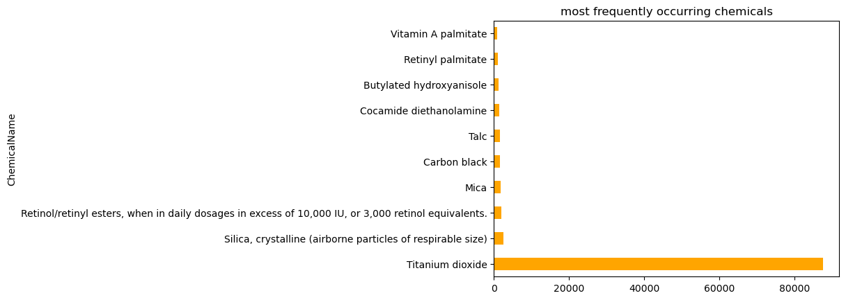
The most frequently Chemicals in cosmetics

Slide 7
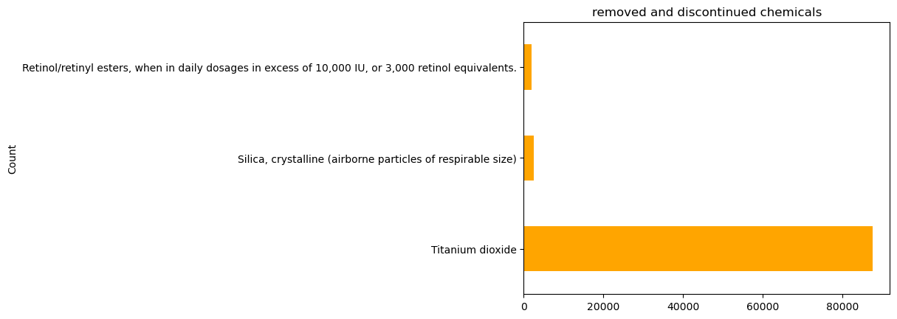
So What happen with Titanium dioxide?

Slide 8
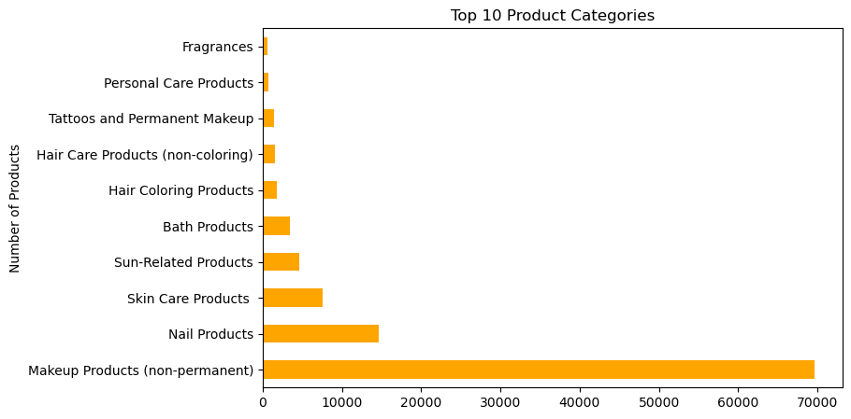
Prime Category

Slide 9
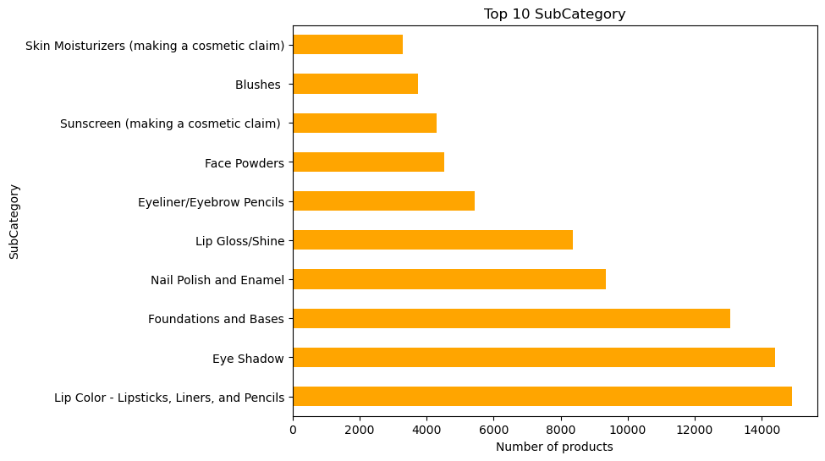
Sub Category

Slide 10
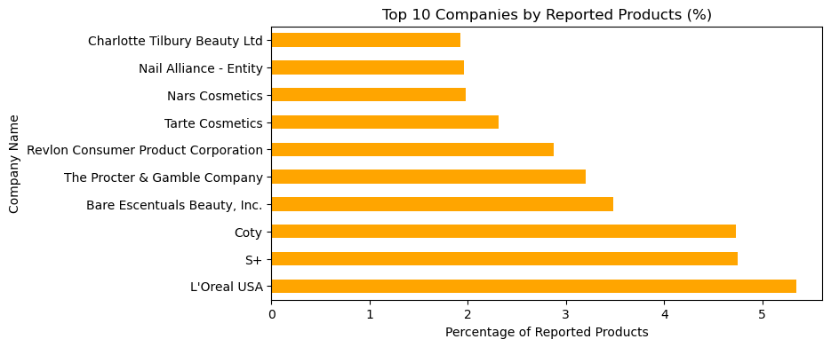
Who’s Reporting What?

Slide 11
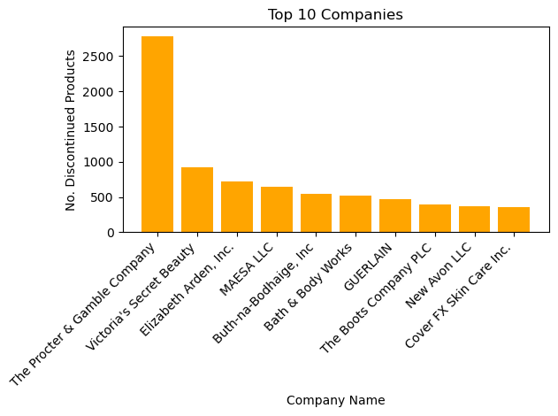
Number of Discontinued Products by Company

Slide 12

Chemical Count
Each cosmetic product contains, on average, 1 chemical compound.
nail products stand out with the highest number of chemical components, reaching up to 5 in a single product.

Slide 13

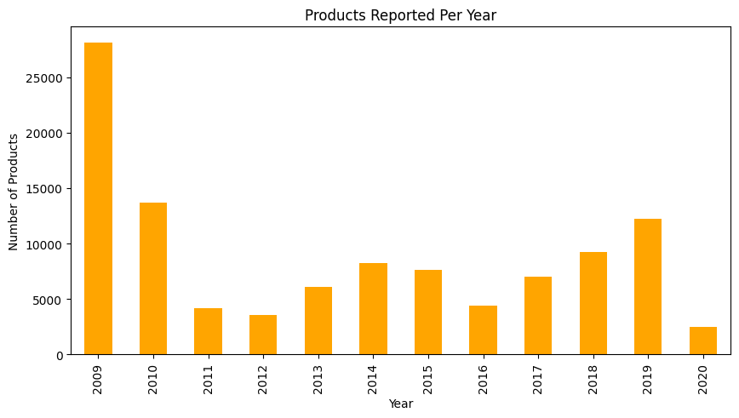

Annual Trends of Reported Products to the CSCP

Slide 14

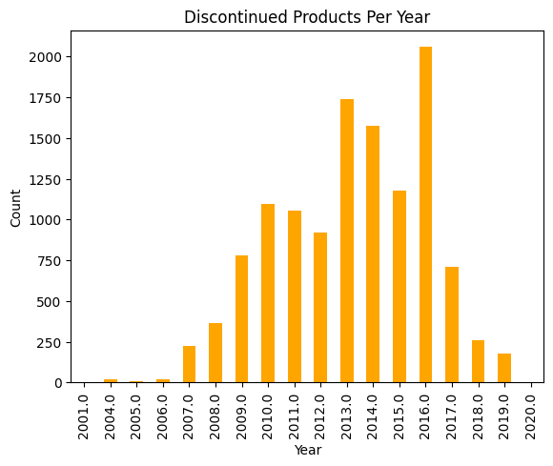
Annual Trends of Discontinuous Products

Slide 15

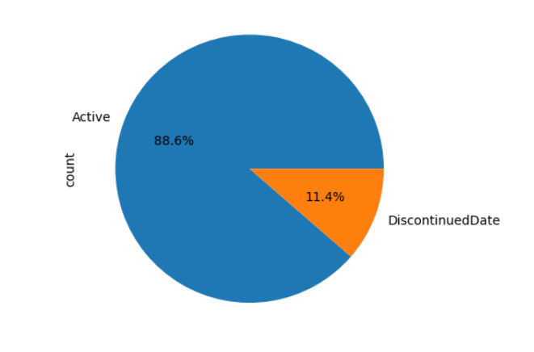
Status Analysis: Active vs. Discontinued Chemicals

Slide 16
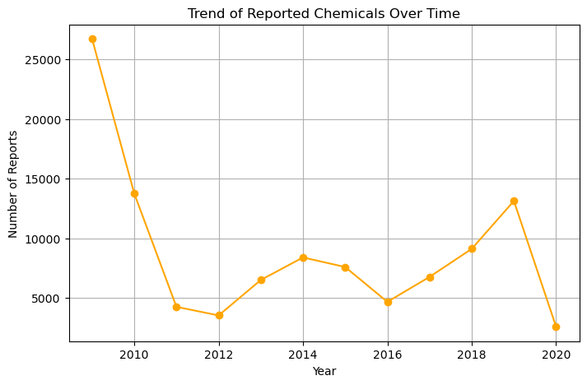
Trends Vs Time
2009: Highest number of reports, around 27,000.
2020: Sharp decline again to around 2,000(lowest point overall).

Slide 17



Conclusion
Harmful chemicals are still used in beauty products.
Nail products often have many toxic ingredients.
Reporting and discontinuation have decreased over time.
Many unsafe products are still on the market.

Slide 18
Recommendations
1
2
3
4
Focus checks on companies with many risky products.
Make the reporting system easier for companies to use.
Compare datasets from different countries
Compare cosmetic ingredients between CSCP data with health data.

Slide 19
Thank You
Any Questions?

